Slide 1



Transjakarta
Data Analysis
Kadek Dean Satrya Pramana

Slide 2

Background
TransJakarta, launched on January 15, 2004, is a bus rapid transit (BRT) system in Jakarta, Indonesia, and was the first of its kind in Southeast Asia. Designed to address Jakarta's severe traffic congestion, it operates on dedicated bus lanes that allow for faster and more reliable transit. The system has grown significantly from a single corridor to one of the largest BRT networks in the world, with numerous corridors spanning the city and surrounding areas.
TransJakarta fleet includes standard, Jakling, and electric buses, Despite challenges like traffic congestion and overcrowding during peak hours, the system has made a substantial impact by improving urban mobility, reducing environmental pollution, and enhancing public access to transportation. The future of TransJakarta includes plans for further expansion, sustainability initiatives with electric buses, and better integration with other public transport systems in the Jakarta metropolitan area.

Slide 3


Question
What does the concentration of individuals in a specific age range suggest about the demographic that primarily uses the service?
Why are certain stops highly popular for both tap-in and tap-out, and what does this indicate about their role in the transportation network?
What factors might contribute to certain stops being rarely used, and how can their utilization be improved?
What characteristics of the busiest corridors make them dominate in terms of passenger volume, and how can this be managed effectively?
What might be the reasons for certain corridors having significantly fewer passengers, and what strategies can be employed to address this underutilization?

Slide 4







Process
Data Understanding
Data Cleaning
EDA
Tableau

Slide 5
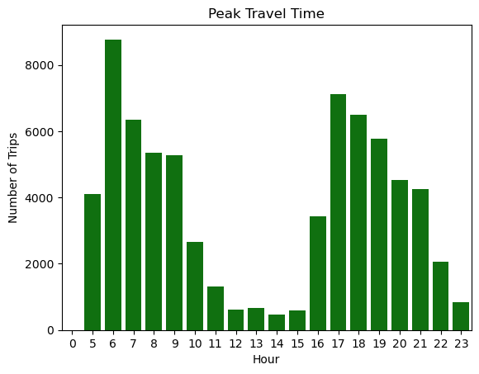
Peak Travel time
Peak Hour: The highest bar is at 6 AM, indicating that this is the time with the most trips, with over 8,000 trips.
Morning Rush: There is a noticeable spike in trips between 5 AM and 8 AM. This likely represents the morning rush hour when people are commuting to work or school.
Midday Drop: After 9 AM, the number of trips drops significantly, reaching a low point between 11 AM and 2 PM. This period might represent a lull in transportation activity, possibly because people are settled at work or school.
Evening Peak: There is another rise in the number of trips around 4 PM to 6 PM, which aligns with the typical evening rush hour as people head back home.
Nighttime Decline: After 8 PM, the number of trips decreases, reaching the lowest point late at night.

Slide 6
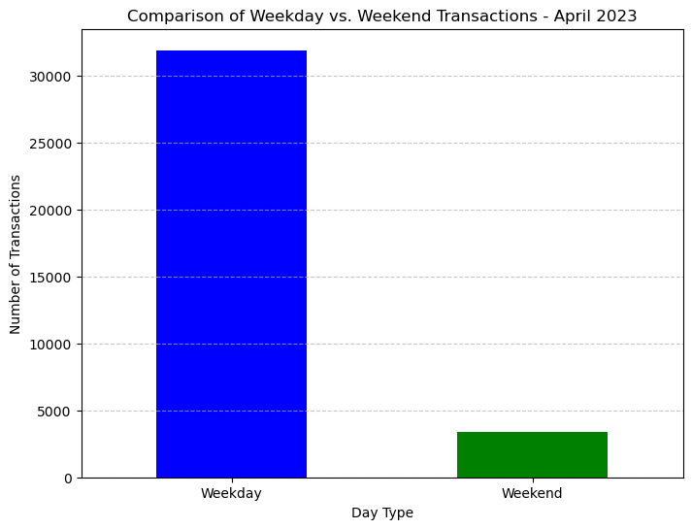
Weekday vs Weekend
Weekday Dominance: The weekday bar is much higher, indicating that the vast majority of transactions occur during the weekdays, with over 30,000 transactions.
Weekend Drop: The weekend bar is significantly shorter, with fewer transactions. This is expected as fewer people commute on weekends, possibly due to less work-related travel.
Implications for Service Planning: This data can be crucial for planning transportation services. Weekday services might need to be more robust to handle the higher demand, while weekend services could be scaled back or adjusted to meet the lower demand.

Slide 7
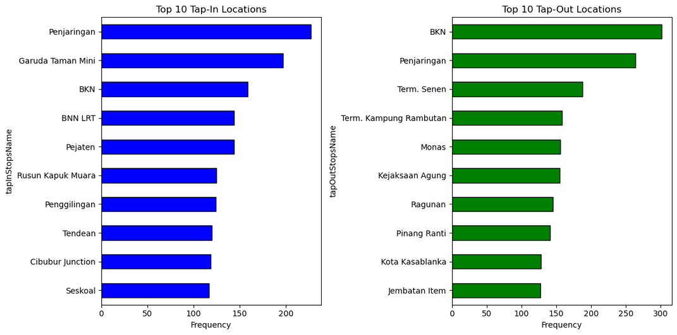
Tap-In and Tap-Out Locations
Top Tap-In Location: "Penjaringan" is the most popular tap-in location, with a frequency significantly higher than other locations. This suggests that Penjaringan is a major starting point for commuters.
Top Tap-Out Location: "BKN" is the most popular tap-out location, indicating it's a major destination for people.
Overlap Between Tap-In and Tap-Out: Some locations, like "BKN" and "Penjaringan," appear in both charts, indicating that they are both popular starting and ending points. This could mean these areas are central in the transportation network, possibly serving as hubs or transfer points.

Slide 8
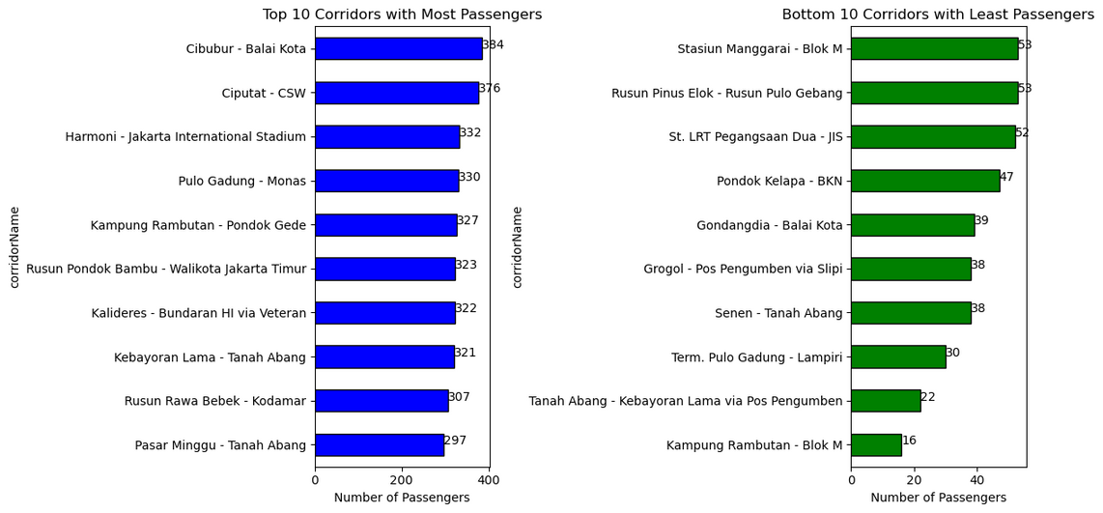
Corridors with Most and Least Passengers
Top Corridors: The "Cibubur - Balai Kota" corridor has the highest number of passengers, with 384 passengers. This indicates that this route is highly utilized, possibly due to its connection between residential areas and a central business district or popular destination.
Bottom Corridors: The "Kampung Rambutan - Blok M" corridor has the fewest passengers, with only 16. This might suggest that this route is either less critical for daily commutes or serves a niche population.
Service Optimization: Understanding which corridors have the most and least passengers can help transportation planners optimize service delivery. High-traffic corridors might require more frequent services, while low-traffic corridors could be candidates for service reductions or restructuring.

Slide 9
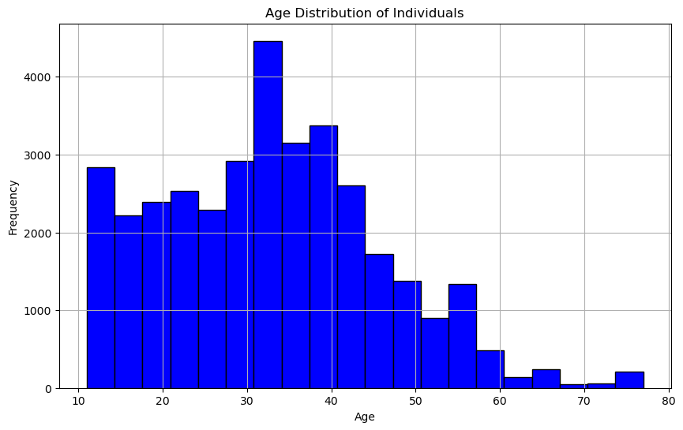
Age Distribution
Younger Individuals (10-20 years): The frequency is relatively moderate, with several age intervals having between 2,000 and 3,000 individuals.
Young Adults (20-30 years): There's an increase in the frequency as age approaches 30, with a noticeable peak around 30-35 years. This suggests that the population skews slightly younger, with a significant number of individuals in their late 20s and early 30s
.
Middle Age (35-50 years): After 35, there is a gradual decline in the frequency, although the population remains substantial up to around 50 years old. This age group is also well-represented, though less so than the younger age groups.
Older Adults (50+ years): After 50 years, the frequency of individuals drops significantly. There are fewer individuals in the age groups beyond 50, with only a small number of people represented in the 60-70 year range and very few beyond 70.

Slide 10
Conclusion
-Peak Travel Time
The data shows a clear pattern of transportation activity corresponding to typical commuting times. There is a significant spike in trips between 5 AM and 8 AM, reflecting the morning rush hour as people commute to work or school. After 9 AM, trips decrease sharply, reaching a low between 11 AM and 2 PM, likely when most people are settled at their destinations. A second peak occurs from 4 PM to 6 PM, aligning with the evening rush hour as people return home. Additionally, the vast majority of transactions happen on weekdays, with over 30,000 transactions, indicating higher commuter activity compared to weekends.
Age Distribution
The age distribution shows a concentration of individuals in a specific age range. This likely indicates a certain demographic group that primarily uses the service, possibly younger or middle-aged adults.

Slide 11
Conclusion
Tap-In and Tap-Out Analysis
Most Frequent Stops : Certain stops are highly popular as both tap-in and tap-out locations, indicating they are key hubs or popular destinations.
Least Frequent Stops : Some stops are rarely used, suggesting they serve less populated areas or less popular routes.
Most and Least Corridor Analysis
Busiest Corridors : A few corridors dominate in terms of passenger volume, likely serving high-demand areas or major routes.
Least Busy Corridors : Conversely, some corridors have significantly fewer passengers, which might indicate underutilization or coverage of areas with low demand.

Slide 12
Solution
For Peak Travel Time
Increase Peak Hour Services: Boost transportation frequency and capacity during the morning (5-8 AM) and evening (4-6 PM) rush hours to handle high commuter traffic.
Promote Off-Peak Travel: Offer discounts and encourage flexible work hours to spread out travel demand across the day.
For Age Groups
Tailored Services: If a particular age group dominates, tailor services to their needs. For instance, younger users might appreciate mobile ticketing options, while older users might value clear signage and seating availability.
Inclusive Planning: Ensure that services are accessible to all age groups, possibly considering special routes or services for underrepresented age groups.

Slide 13
Solution
For the Most Frequent Stops
- Enhance Services: Consider increasing the frequency of services in these areas to accommodate high demand, reducing wait times, and improving customer satisfaction.
- Infrastructure Improvement: Upgrading infrastructure, such as shelters, seating, or digital information boards, at these popular stops can improve the user experience.
- Marketing Opportunities: These hubs can be targeted for marketing campaigns or partnerships due to high foot traffic.

Slide 14
Solution
For the Least Frequent Stops
Analyze and Adapt Services: Evaluate the reasons for low usage—whether it’s due to service timings, lack of awareness, or poor connectivity. Adjust services accordingly, perhaps by rerouting, changing schedules, or even reducing service frequency if it's not justifiable.
Community Engagement: Engage with local communities to understand their needs better. This might involve adjusting routes or service times to better fit their schedules, which could increase usage.
Promotional Campaigns: Launch promotional campaigns to raise awareness of these lesser-used routes and stops, possibly offering discounts or incentives to encourage more usage.

Slide 15
Solution
For Corridor
Investment in Key Corridors: Focus investment on improving the infrastructure and service quality of the busiest corridors to ensure they can handle the high volume of passengers without degradation of service.
Reallocation of Resources: Consider reallocating resources from underutilized corridors to those with higher demand, or use the savings to enhance community outreach and service adaptation in underutilized areas.

Slide 16
Thank You

